Slide 1
CHAPTER 3
Data Structures and Algorithm Analysis in Java 3rd Edition by Mark Allen Weiss

Slide 2
ABSTRACT DATA TYPES
An abstract data type is a set of objects with a set of operations.
Focused on defining the operations (what) but not the implementation (how) of the operations.
Classes implement ADTs, separating the interface from the implementation.
Objects such as lists, sets and graphs, along with their operations can be viewed as ADTs.
ADTs is focused on what should happen not how the implementation of operations.

Slide 3
ADTs
The List ADT
The Stack ADT
The Queue ADT

Slide 4
The List ADT
General List : A₀, A₁, A₂,…A_{i-1}, A_{i}, A_{i+1}, … ,A_{N-1} Size = N
List of size zero is called empty list
The Position of element A_{i} in a list is i
Iterable
Collection
List
ArrayList
LinkedList
implement
Class
extends
Interface

Slide 5
Operations on List ADT
printList
makeEmpty
Find
returns position of first occurrence
Insert
Insert element at a specific position
Remove
remove element at a specific position
findKth
Return element at kth position

Slide 6
Example
List : 34, 12, 52, 16, 12
find(52) = 2
insert(60,2) will make list : insert and shift to right
34, 12, 60, 52, 16, 12
remove (52) will make list: remove and shift to the left
34, 12, 60, 16, 12

Slide 7
Array Implementation of List
int [] arr = new int[10];
…
//Later on we decide arr needs to be large.
int [] newArr = new int[arr.length*2];
for(i=0; i<arr.length; i++)
newArr[i] = arr[i];
arr = newArr
* Fixed capacity

Slide 8
Array Implementation of List
The findKth operation takes constant time, O(1).
Similarly, removing and adding from the end of array is constant time, O(1).
An array implementation allows printList to be carried out in Linear Time O(N)
insertion and deletion takes O(N)
Worst case move all elements. (index = 0)
If insertion and deletion occur throughout the list including at the front of the list, then the array is not a good option.

Slide 9

LINKED LIST
data
next
The linked list consist of series of nodes which are not necessarily adjacent in the memory.
Avoids the linear cost of insertion and deletion caused by Array.
findKth(i) takes O(i) ~ O(N)
Because Linked List not indexed, need to traverse the list from beginning to end.

Slide 10
remove
The remove method can be executed in one next reference change.

Slide 11
insert
The insert method requires obtaining a new node from system by using a new call and then executing two reference maneuvers.

Slide 12
DOUBLY LINKED LIST
We have every node maintain a link to its previous node in the list and one pointing to next node in the list.
Storage cost and time increase because of extra pointer
It saves time on deletes since no longer need to search to find the previous node, which was necessary with single linked list.
previous and next pointers

Slide 13
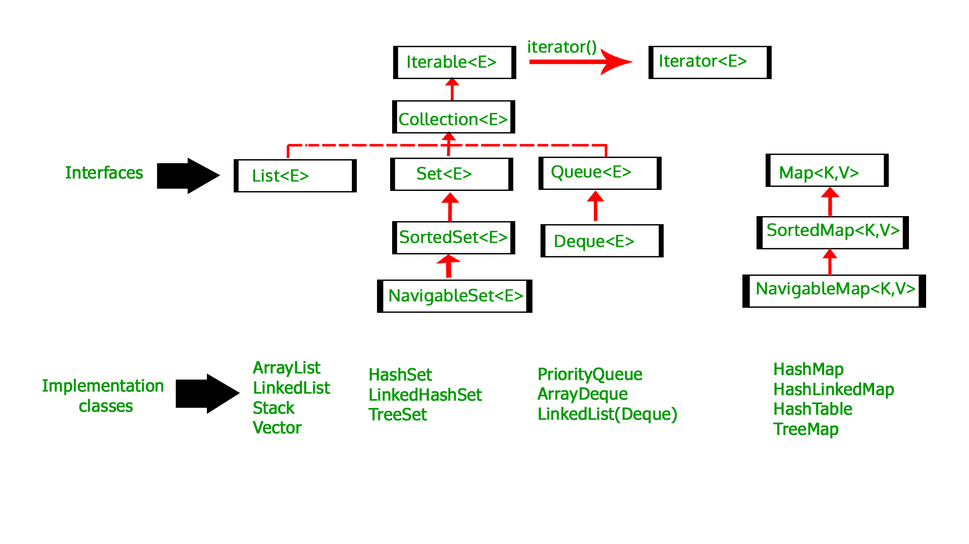
Java Collections API
The Java language includes, in its library, an implementation of common data structures.
Collections API part of java library includes: interfaces, implementations(classes) and algorithms (collections.sort()).
Collections implements Collection interface in java.
The List ADT is one of the data structures implemented in Collections API ( ArrayList and LinkedList)

Slide 14
Collection Interface
The Collection API resides in the package java.util.
A collection stores objects of same type
It has methods like
isEmpty
size
contains
add
remove
The Collection interface extends Iterable interface for iterating through the collection.
Classes that implement Iterable interface can have the enhanced for loop

Slide 15
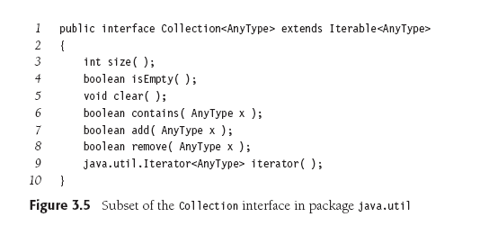
Collections Interface
Interface inheritance from interface → extends

Slide 16
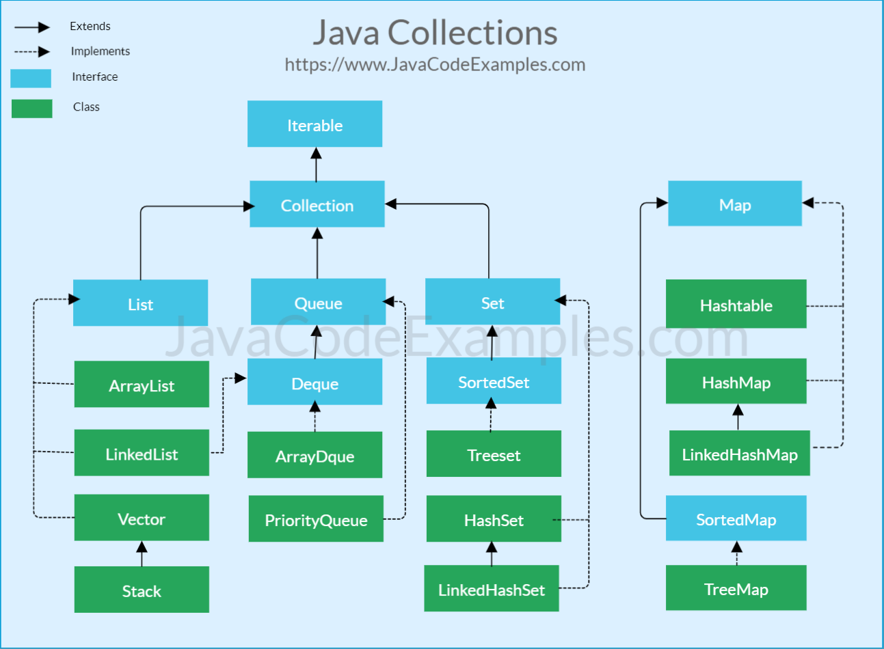
Overview
By Geeks for Geeks

Slide 17
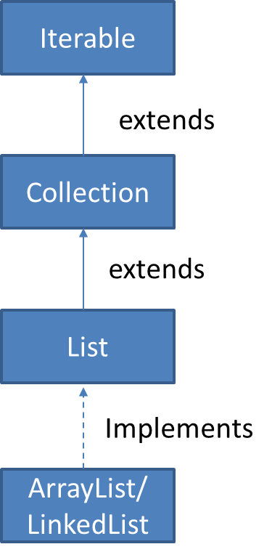
Iterable Interface
The Collection interface extends Iterable interface.
Classes that implement Iterable interface can have enhanced for loop (for-each loop).
Collections that implement Iterable interface must provide a method named Iterator that returns an object of type Iterator.

Slide 18
Iterator Interface
public interface Iterable<AnyType>
{
Iterator<AnyType> iterator();
}
// Iterable interface
Implement Iterable interface along with its methods including iterator()

Slide 19
Enhanced for loop
Enhanced for loop in Iterable type

Slide 20
Iterators
Enhanced for-loops use iterators.
The remove method on an iterator is preferred over the remove method of a collection
Reason 1: Because the iterator already has the item’s position.
An iterator’s remove will remove the last item returned by the iterator’s next() method.
After which you must then call next() again before calling remove()

Slide 21
Iterators
If the collection is changed using its own methods(add, remove or clear), it invalidates the iterator.
ConcurrentModificationException
(Reason 2)This is another advantage of calling the remove() method of an iterator, as it does not invalidate the iterator.

Slide 22
List Interface (ArrayList and LinkedList)
The List interface extends Collection interface.
it contains all methods in Collection and few others.
get : access from specific position
set : change from specific position
add: place new item at specific position
remove : remove item from specific position
listIterator(): return object of type ListIterator<AnyType>

Slide 23
List interface

Slide 24
List Interface
add will add an item at the index location, pushing other members down the list.
An add at position 0 adds to the front of the list.

Slide 25
Implementation of List ADT
ArrayList provides a growable array implementation of List.
Advantage: get() and set() are constant time
Disadvantage: insertion and deletion within the list are expensive
Especially at the beginning
LinkedList provides linked list implementation of List
Doubly linked list implementation
Advantage: insertion and deletion within list are cheap, provided index is known.
Especially adding/removing at the beginning
Disadvantage: not indexable, so get() and set() are expensive O(N) because
Unless they are close to the ends of the list.

Slide 26
Comparing ArrayList and LinkedList
public static void makeList1(List<integer> lst, int N)
{
lst.clear();
for( int i = 0; i< N; i++)
lst.add( i ) ;
}
ArrayList will take O(N) because the end can be referenced in constant time, and the loop has N iterations.
LinkedList is O(N) since it has a reference to the last node, so references to the end take constant time, with N iterations.

Slide 27
Comparing ArrayList and LinkedList
public static void makeList2(List<integer> lst, int N)
{
lst.clear();
for( int i = 0; i< N; i++)
lst.add( 0, i ); //add to front of list
}
ArrayList will take O(N²) because the adding to the front requires moving the other elements down, which takes O(N) time, and there are N iterations.
LinkedList will take O(N) since adding to the front only requires O(1) time, with N iterations.

Slide 28
Comparing ArrayList and LinkedList
public static int sum(List<integer> lst)
{
int total = 0 ;
for( int i = 0; i < N; i++)
total = total + lst.get( i ) ;
}
ArrayList will take O(N) because getting a value at an index position is O(1), with O(N) iterations.
LinkedList will take O(N²) since getting the value at ith index takes O(N) time, with O(N) iterations.
Improved to O(N) by using enhanced for-loop, because iterator efficiently advances from one item to the next.

Slide 29
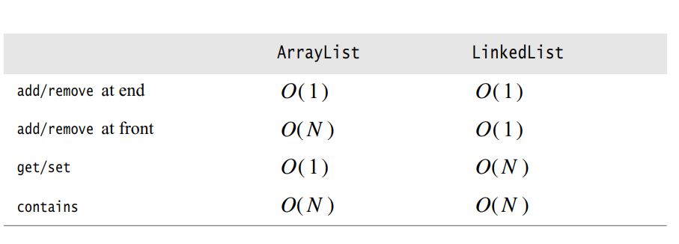
Comparing ArrayList and LinkedList
Data Structures and Algorithm Analysis in JAVA 4th edition by Mark Weiss

Slide 30
Comparing ArrayList and LinkedList
Methods that require a search on either list type take O(N).
Collection contains() and remove()
The ArrayList also has a capacity.
It will expand as needed, ensureCapacity()
An initial estimate can be given to avoid periodic expansions.
A “trimToSize” method will also shrink it to its required size to avoid wasting extra space.

Slide 31
Example: Using remove
Remove all the even valued items in a list by using get() and remove()
For an ArrayList, get() is O(1) by index, but remove must shift the items over which is O(N). The loop makes N iterations, so O(N²) is required.
For a LinkedList, get() requires a O(N) search, as does remove(). The loop makes N iterations, so O(N²) is required.

Slide 32
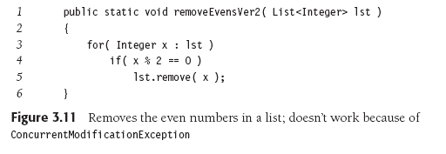
Using Enhanced for loop
// implicit iterator
// iterator invalidated!
Enhanced for loop uses iterator to avoid get() call.
But the remove() call from collections on the list invalidates the iterator!
So, this code does not work, as it throws an concurrentModificationException.

Slide 33
Using Iterator
Get our own iterator.
Use Iterators remove method → constant time as location already known (unlike Collection remove method)
The loop makes N iterations.
LinkedList will take O(N) since iterator already has the position.
ArrayList still takes O(N²) because items must be shifted.

Slide 34
ListIterator extends to Iterator for Lists
Adds functionality:
previous() and hasPrevious() to traverse list.
add() to complement remove. (between next() and previous())
set() to change a value.

Slide 35
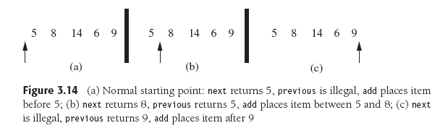

Slide 36
Implementation Of ArrayList
http://users.cs.fiu.edu/~weiss/dsaajava3/code/MyArrayList.java
To avoid ambiguities with the library class, we will name our class MyArrayList.
it maintains the underlying array, the array capacity and current number of items stored in the MyArrayList.
provides a mechanism to change the capacity of the underlying array.
implementation of get and set
routines such as size, isEmpty, clear, add, remove ..
provides a class that implements Iterator interface.

Slide 39
Routines
ensureCapacity
Used to expand capacity as well as shrink the underlying array.
At line 46, an idiom that is required because generic array creation is illegal.
Use an array cast
add
computational expensive
requires increasing capacity of the array
remove
similar to add

Slide 40
Iterator method
iterator method returns an instance of ArrayListIterator, which is a class that implements iterator interface.
ArrayListInterator is a inner class, this is allowed in java.
It should be an inner class to use the data items from MyArrayList class like theItems variable.

Slide 41
Erroneous Code

Slide 42
theItems is private field and not accessible outside the class

Slide 44
Nested Class and Inner Class
Provides Encapsulation of data
Provides Readable and maintainable code
Difference between nested class and inner class is nested class are static so they are associated with class not with the instance of the class.
inner classes are associated with outer class objects (instance of outer class).
inner class is useful in a situation in which each inner class object is associated with exactly one instance of an outer class object.

Slide 46
Private MyArrayList<AnyType> theList;
MyArrayList.this.size()
MyArrayList.this.theItems[current++]
Clean and easy to understand representation like Version#1

Slide 47
Implementation of LinkedList
Implementing a linked list can be made easier by using a header node to mark the start of the list and a tail node to mark the end.
These nodes are referred to as sentinel nodes.
In design three classes are provided
MyLinkedList
Node
LinkedListIterator

Slide 48
Advantages of these extra nodes
Greatly simplifies the code ( insertion and deletion)
For example without the header node then removing the first element becomes a special case
Beginning of list : head node
End of list : tail node

Slide 49
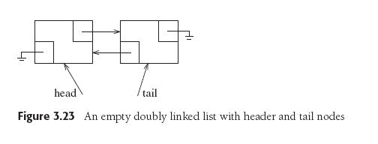
EMPTY LIST
An empty list still has two nodes

Slide 50
MyLinkedList
The author provides implementation of his own version of a doubly LinkedList “MyLinkedList”.
http://users.cis.fiu.edu/~weiss/dsaajava3/code/MyLinkedList.java

Slide 51
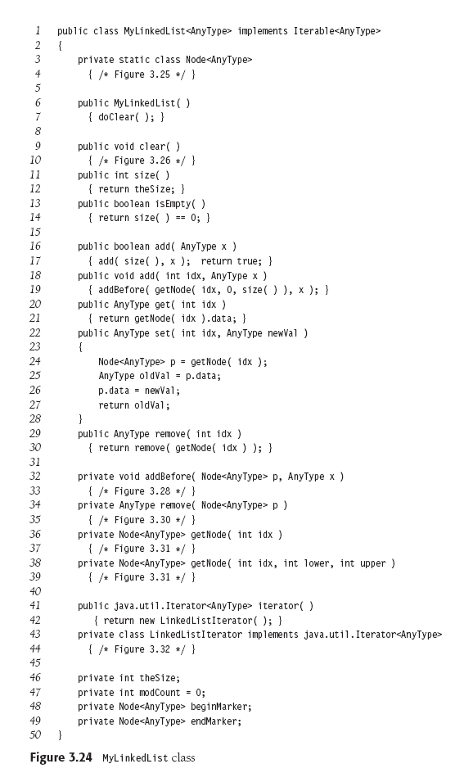

Slide 52
Node Class

Slide 53
clear and doclear methods

Slide 54
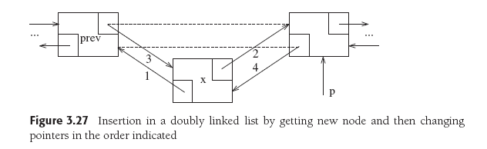
addBefore Method

Slide 55
addBefore Method

Slide 56
Removing node p

Slide 57
Removing node p

Slide 58
getNode() Method
if the index represents a node in the first half of the list then we step through the linked lit, in the forward direction otherwise we go backward starting at the end.

Slide 60
Linked List Iterator
Incorporates significant error checking.
data field expectedModCount stores the modCount of the linked list at the time iterator is constructed.
Boolean data field okToRemove is set to false initially and set to true in next and set to false in remove .

Slide 61
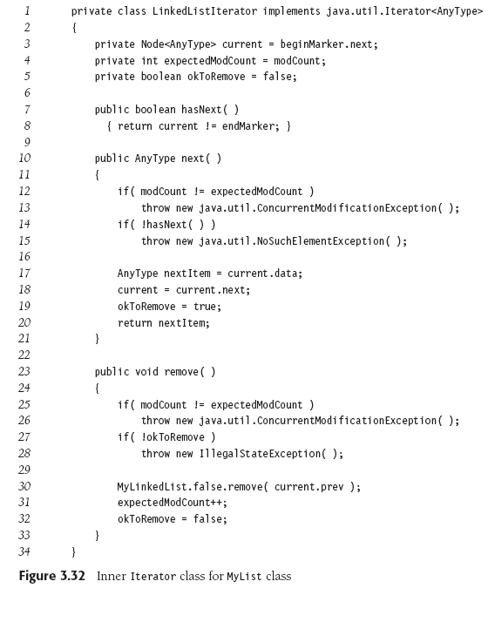

Slide 62
The Stack ADT
A stack is a list with restriction that can only have insertions and deletions from the end of the list called top.
Operations on Stack
Push : Insertion
Pop : Deletion
Top : To glance at top element without popping
Stacks are Last In, First Out strucutres (LIFO)

Slide 63
Stack Model

Slide 64
LIFO List

Slide 65
Implementation of Stack LinkedList
Any list implementation will do. Either ArrayList or LinkedList
Linked List implementation of Stacks
Singly linked list is enough
push inserts at the front of the list
pop deletes and returns the front list item
top just returns the front list item
All operations will take O(1) as no dependence on the stack size

Slide 66
Implementation of Stack ArrayList
Pop, Push and Top will also take O(1) time if performed at the end of the list
Associated with each stack is theArray and topOfStack which is -1 initially.
To push some element x , increment topOfStack and then set , add to the end of the list
theArray[topOfStack] = x
To pop return theArray[topOfStack] and decrement topOfStack, remove from the end of the list

Slide 67
Applications Of Stack
Balancing Symbols
Postfix Expressions
Infix to Postfix Conversion
Method Calls

Slide 68
Balancing Symbols
A program that checks whether everything is balanced. Every right brace, bracket and parenthesis must correspond to its left counterpart.
[()] – Legal
[(]) – Illegal
It is easy to check these using stack data type

Slide 69
Algorithm
Make an empty stack.
If the character is an opening symbol, push it onto the stack
if it is a closing symbol, pop the stack, if symbol popped is not the corresponding opening symbol , report an error
At end of file, if the stack should be empty, if is not empty report an error.

Slide 70
Postfix Expressions
Postfix Expression Result
4 5 + 9
9 3 / 3
9 8 - 1
This is also called reverse polished notation.
Stack can be used to evaluate postfix expressions.
Postfix notation solves problem: should 4+6+3*10 be 130 or 40?

Slide 71
Algorithm
When a number, operand, is seen push into stack
When an operator is seen pop two numbers, apply the operator on them and push the result onto the stack
For example expression
6523+8*+3+*

Slide 72
6523+8*+3+*
The First Four numbers are pushed
a ‘+’ is read 3 and 2 are popped and result 5 is pushed
topOfStack ->
3
2
5
6
5
5
6
topOfStack ->
Next 8 is pushed
Next a ‘*’ is seen so 8 and 5 are popped and the result 40 is pushed
topOfStack ->
8
5
5
6
40
5
6
topOfStack ->

Slide 73
Next a ‘+’ is seen so 40 and 5 are popped and the result 45 is pushed
6523+8*+3+*
Now 3 is pushed
45
6
3
45
6
topOfStack ->
topOfStack ->
Nest ‘+’ pops 3 and 45 and pushes 48
a ‘*’ is seen 48 and 6 is popped and 288 is pushed
48
6
288
topOfStack ->
topOfStack ->

Slide 74
Infix to Postfix Conversion
Stack can be used to convert from infix to postfix
infix expression : a + b * c + ( d * e + f ) * g
postfix expression : abc*+de*f+g*+

Slide 75
Algorithm
Stack is initially empty
When an operand is read it is immediately placed onto the output.
If we see a right parenthesis, then we pop stack writing symbols until we see left parenthesis which is popped but not output.
if we see any other symbol (, +, *, then we pop the entire stack until we see lower priority one exception is we never remove ( unless we encounter )

Slide 76
a + b * c + ( d * e + f ) * g
a
a
a
a
+
a
ab
+
a
ab
*
+

Slide 77
a + b * c + ( d * e + f ) * g
a
abc
*
+
a
abc*+
+
a
abc*+
+
a
abc*+
(
+

Slide 78
a + b * c + ( d * e + f ) * g
a
abc*+d
(
+
*
(
+
a
abc*+d
*
(
+
a
abc*+de
+
(
+
a
abc*+de*

Slide 79
a + b * c + ( d * e + f ) * g
+
(
+
a
abc*+de*f
a
abc*+de*f+
+
a
abc*+de*f+
*
+
a
abc*+de*f+g
+
abc*+de*f+g*+

Slide 80
Method Calls
Problem: When a call is made to a new method all the local variables and current location, arguments need to be saved. This is achieved by pushing onto the stack.
Method call and method return are same as an open and closed parenthesis.
Stack is used by the programming language in implementing recursion

Slide 81
The Queue ADT
Insertion are done at one end and deletion at the other end. (LILO or FIFO)
First In First Out structures
Basic Operations
enqueue - inserts an element at the end of the list
dequeue – deleted the element at the start of the list

Slide 82
The Queue ADT

Slide 83
Enqueue 1, 2, 3, 4
Dequeue
FIFO
1
1
2
3
4
2
3
4
front
back
front
back
Queue

Slide 84
Array Implementation
O(1) running time for both operations
For each queue data structure we keep an array theArray and positions front and back.
currentSize is used to keep track of number of elements.
Every enqueue advances the back, and every dequeue advances the front, so that the front index appears to “chase” the back index.
If the back index reaches the end of the array, it may wrap to the beginning. This is called a “circular queue”.

Slide 85
Example
5
2
7
1
front
back
Shows a queue in some intermediate state.

Slide 86
Operations
enqueue
increment currentSize and back
set theArray[back] = x
dequeue
return theArray[front]
decrement currentSize and then increment front

Slide 87
Initial
back
front
Enqueue 1,2,3,4
1
2
3
4
front
back
Dequeue twice
3
4
front
back

Slide 88
Enqueue 7,8,9,10
3
4
7
8
9
10
front
back
Enqueue 11, 12
11
12
3
4
7
8
9
10
Queue is full
back
front
Dequeue twice
11
12
7
8
9
10
back
front

Slide 89
Circular Array Implementation
2
4
front
back
After enqueue(1)
1
2
4
back
front

Slide 90
After enqueue(3)
1
3
2
4
back
front
After dequeue which returns 2
1
3
2
4
back
front
After dequeue which returns 4
1
3
2
4
back
front

Slide 91
After dequeue which returns 1
1
3
2
4
back
front
After dequeue which returns 3 and makes the Queue Empty
1
3
2
4
back
front

Slide 92
Applications of Queues
When jobs are submitted to a printer, they are arranged in order of arrival.
Computer networks
Calls to large companies
Wherever resources are limited queues are used

Slide 93
End of Chapter 3

Slide 94

TWO STACKS IN ONE ARRAY
How can you implement two stacks in a single array, where no stack overflows until no space left in the entire array space?
Analysis: An array has two ends, so each of the two stacks may grow from an end in the array.
Since two stacks are empty at first, so indexes of top items are initialized as -1 and 10 at first. When items are pushed into first stack, it grows from left to right. Similarly, the second stack grows from right to left when items are items are pushed into it.

Slide 95

﻿No more items can be pushed into stacks when two top items are adjacent to each other, because all space in the array has been occupied.
﻿No more items can be pushed into stacks when two top items are adjacent to each other, because all space in the array has been occupied.

Slide 96
3 Stacks in One Array
Three stacks can be implemented by having one grow from the bottom up, another from the top down and a third somewhere in the middle growing in some (arbitrary) direction. If the third stack collides with either of the other two, it needs to be moved. A reasonable strategy is to move it so that its center (at the time of the move) is halfway between the tops of the other two stacks.

Slide 97
Implementation of Queue Using Circular Array
import java.util.*;
public class SingleQueueArray<AnyType>
{
SingleQueueArray()
{ this(101); } // note: actually holds one less than given size
SingleQueueArray(int s)
{
maxSize = s;
front = 0;
rear = 0;
elements = new ArrayList<AnyType>(maxSize);
}
void enqueue(AnyType x)
{
if ( !full() )
{
if (elements.size() < maxSize) // add elements until size is reached
elements.add(x);
else
elements.set(rear, x); // after size is reached, use set
rear = (rear + 1) % max Size;
}
}

Slide 98
AnyType dequeue()
{
AnyType temp=null;
if ( !empty() )
{
temp = elements.get(front);
front = (front+1) % maxSize;
}
return temp;
}
boolean empty()
{ return front == rear; }
boolean full()
{ return (rear + 1) % maxSize == front; )
private int front, rear;
private int maxSize;
private ArrayList<AnyType> elements;
}

Slide 99
Implementation of Queue Using Linked List
public class SingleQueue<AnyType>
{
SingleQueue()
{
front = null;
rear = null;
}
void enqueue(AnyType x)
{
Node<AnyType> p = new Node<AnyType>(x, null);
if (rear != null)
rear = rear.next = p;
else
front = rear = p;
}
AnyType dequeue()
{
AnyType temp = front.data;
if (front.next == null) // only 1 node
front = rear = null;
else
front = front.next;
return temp;
}

Slide 100
Implementation of Queue Using Linked List
private class Node<AnyType>
{
Node()
{ this(null, null); }
Node(AnyType x)
{ this(x, null); }
Node(AnyType x, Node p)
{
data = x;
next = p;
}
AnyType data;
Node next;
}
private Node<AnyType> front, rear;
}

